Slide 1


Department of Electronics and Communication Engineering
Data Transmission through Ultrasonic Sound
By:
Shreyas R PES1201701714
Praphul Gowda PES1201700237
Karthik K Bhat PES1201701499
Guides:
Dr. Anuradha M
Mrs. Savithri K R
Ms. Shilpa Hosur

Slide 2
Abstract
This project is an approach towards establishing a secure data transmission using ultrasonic sound.
Short-range connectivity among electronic devices is essential to build a connected world.
The rapidly increasing technologies of communication have a common purpose of increasing data rates and a hack-proof communication.
Radio Frequency based wireless communication rely on high power transmitters.
This prototype consists of a simple transmitter and receiver circuit which employs ultrasonic transducers to transfer data

Slide 3
Introduction
Data can be transmitted with standard speakers and microphones.
Establishing a Bluetooth or Wi-Fi connection takes multiple seconds, whereas sound playback or recording can start in tens of milliseconds.
Ultrasonic bypasses the physical limitation of short-range RF.
Unlike RF, ultrasonic does not pass through walls, data is “within earshot.”
Properties of sound enable quick localised data transfers which is key factor in sharing resources based on proximity.^{[3]}

Slide 4
Problem Statement
Design a prototype that is able to transfer digital data using ultrasonic sound
# | Details | Value | Unit
1 | Transmission Length | 20 | centimetre
2 | Transmitter Power | 100 | Milli Watt
3 | Power Supply | 5 | Volts
4 | Transmission Speed | 80 | bps
5 | Ultrasonic Sound frequency | 40 | kHz
6

Slide 5
Literature Survey
Kerry D. Wong, “A Sensitive DIY Ultrasonic range sensor”, 2011
This paper discusses about ultrasonic transducers. This paper also introduces us to the transmitter circuit.
It uses a bridge circuit produces an output voltage roughly twice the Vcc. ^{[6]}
Pascal Getreuer , Chet Gnegy, Richard F. Lyon, Life Fellow, IEEE, and Rif A. Saurous. “Ultrasonic Communication Using Consumer Hardware”, 2018
The 18.5 to-20 kHz is inaudible to most humans and yet realizable with commodity speakers and microphones in mobile devices.
Speakers of common phone produces 74 dB SPL at 18 kHz whereas the threshold is 86 dB SPL to be audible. ^{[1]}

Slide 6
Literature Survey
Jonny Biguenet, “Ultrasonic data “transmission” , 2016
This paper gives us an insight about the problems faced during the design of transmitter and receiver circuit.
Audio hardware limitations include inability of transmission of binary data through normal speakers.
V A Zhmud1, N O Kondratiev1, K A Kuznetsov1, V G Trubin1, L V Dimitrov, “Application of ultrasonic sensor for measuring distances in robotics”, 2018
This paper gives an idea about working and internal circuits of ultrasonic sensor HC-SR04.
The ultrasonic transducers used in this sensor respond to binary data. The circuits assisted in designing the receiver and transmitter circuit.

Slide 7
Approach
Microcontroller
Ultrasonic Transmitter
Ultrasonic Receiver
Microcontroller
Data to be sent
Data received

Slide 8
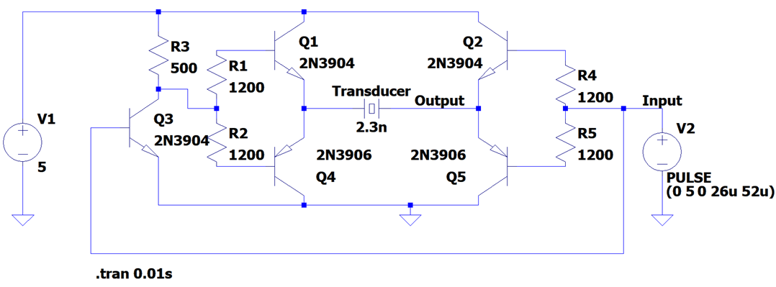
Transmitter Schematic
Notes:
>> Uses PNP and NPN transistors to bring the current levels to an optimum range which is suitable for the ultrasonic transducers to operate.
>> The current levels varies with respect to the message signal.

Slide 9
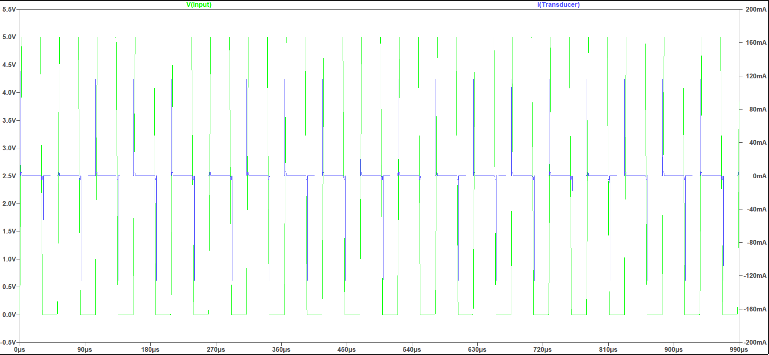
Transmitter Circuit Simulation
Simulation of Ultrasonic Transducer Driver Circuit on LTSpice software

Slide 10
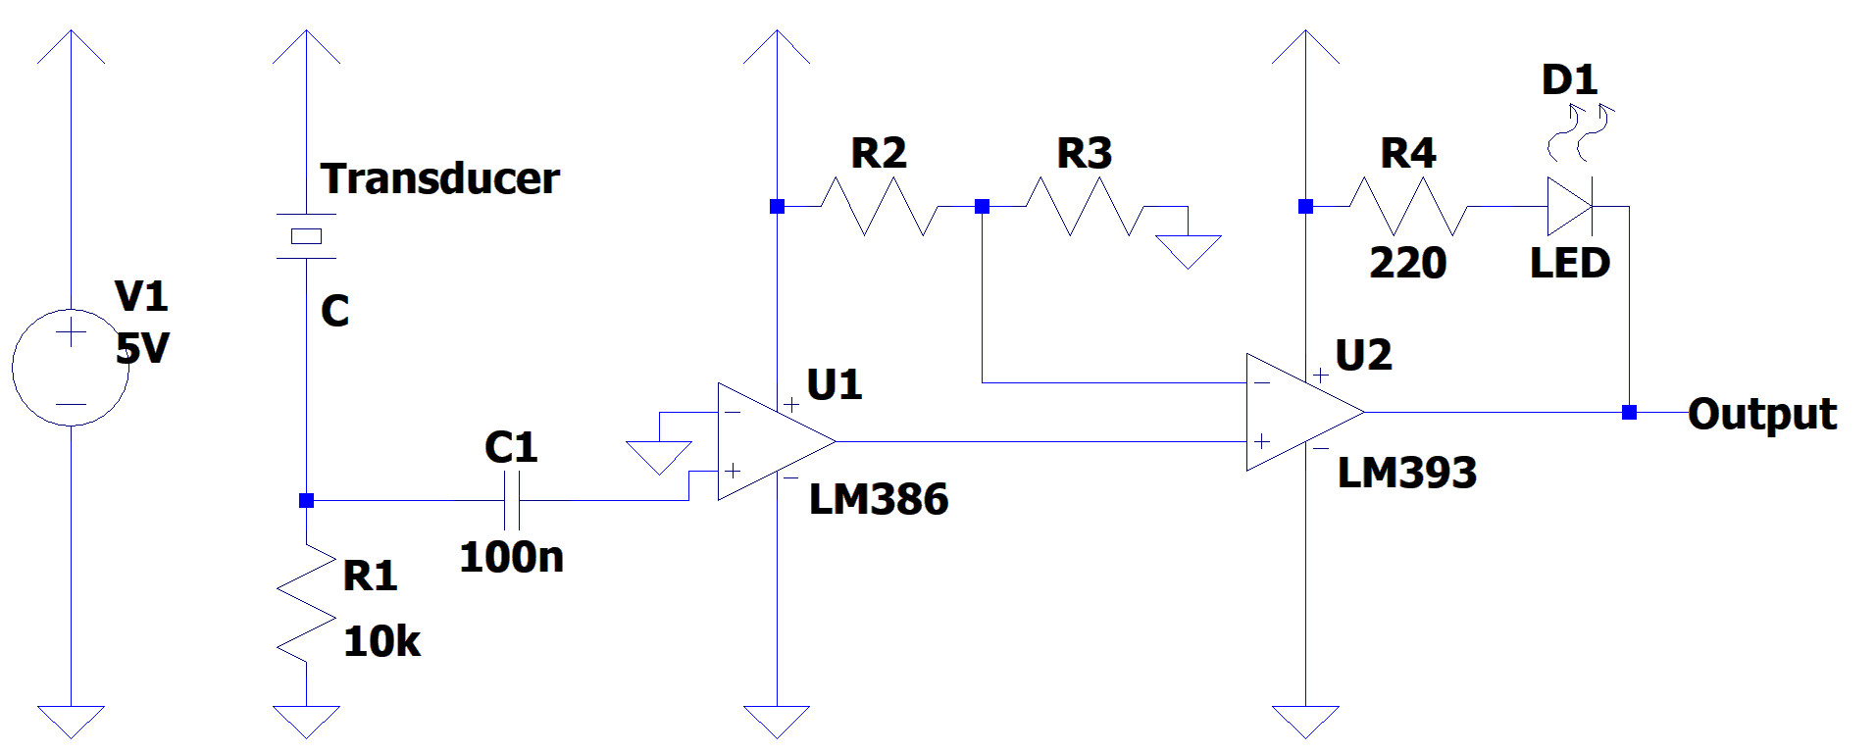
Receiver Schematic

Slide 11
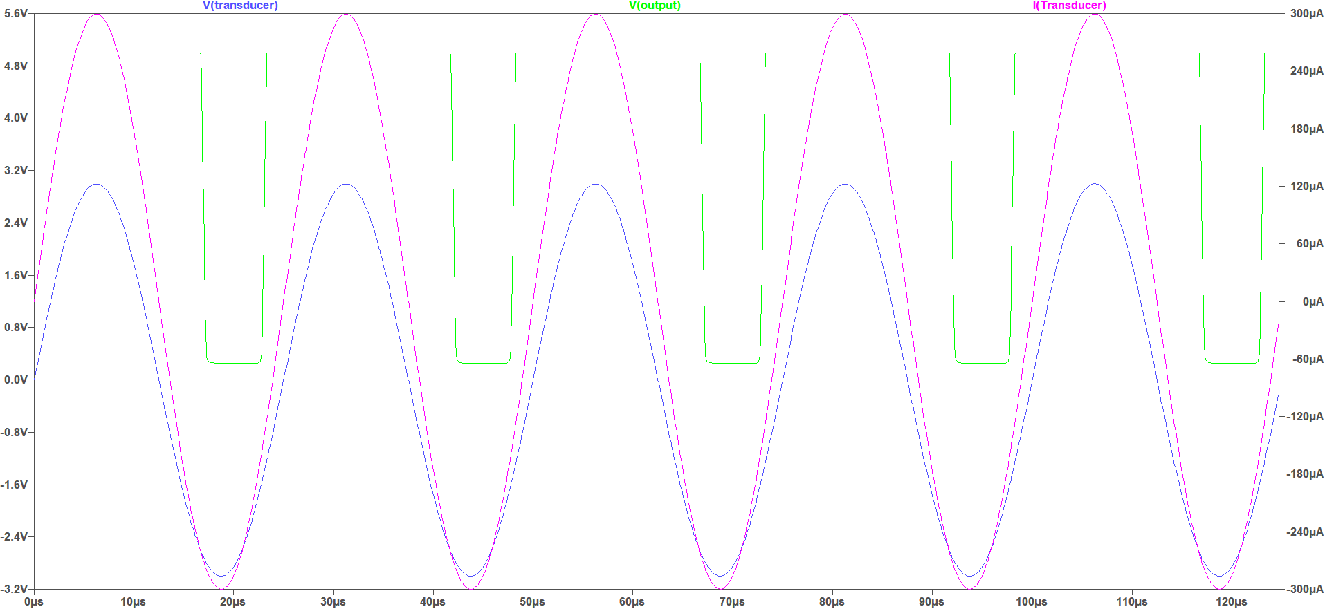
Receiver Circuit Simulation
Simulation of Receiver Circuit on LTSpice software
Simulation of Receiver Circuit on LTSpice software

Slide 12
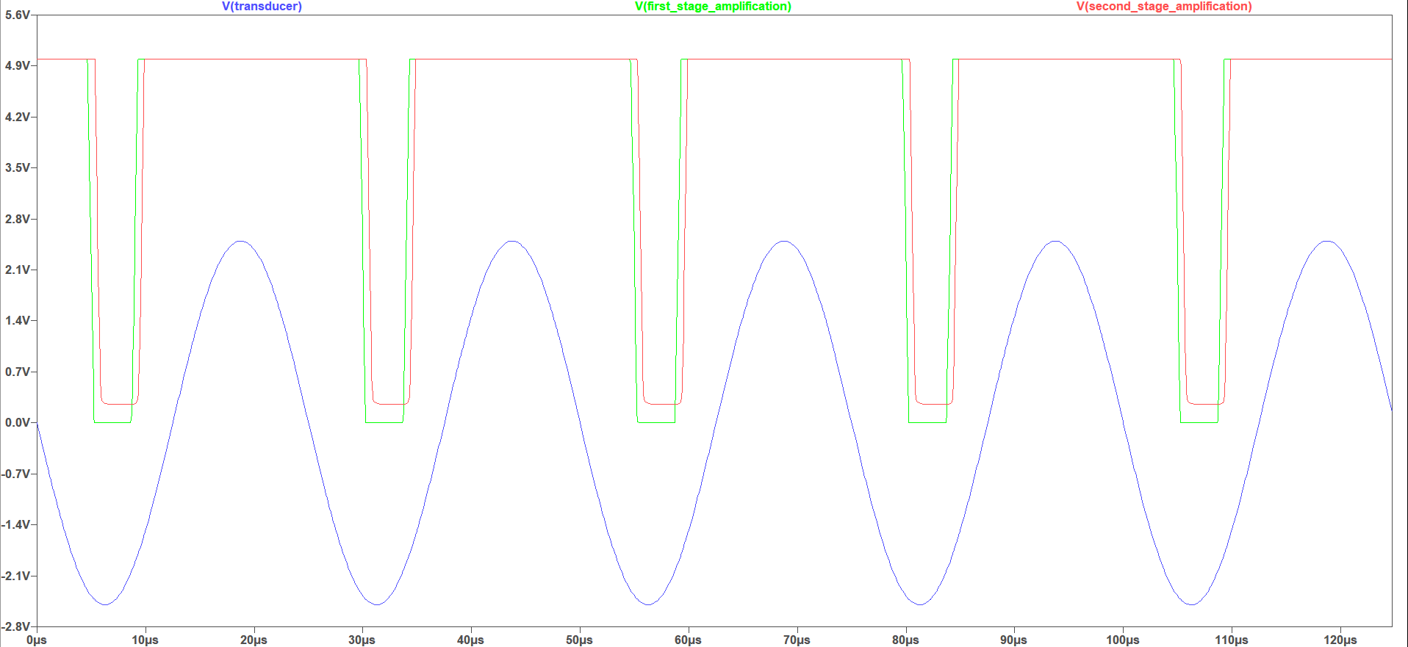
Receiver Circuit Simulation
Simulation of Receiver Circuit on LTSpice software
Simulation of Receiver Circuit on LTSpice software

Slide 13
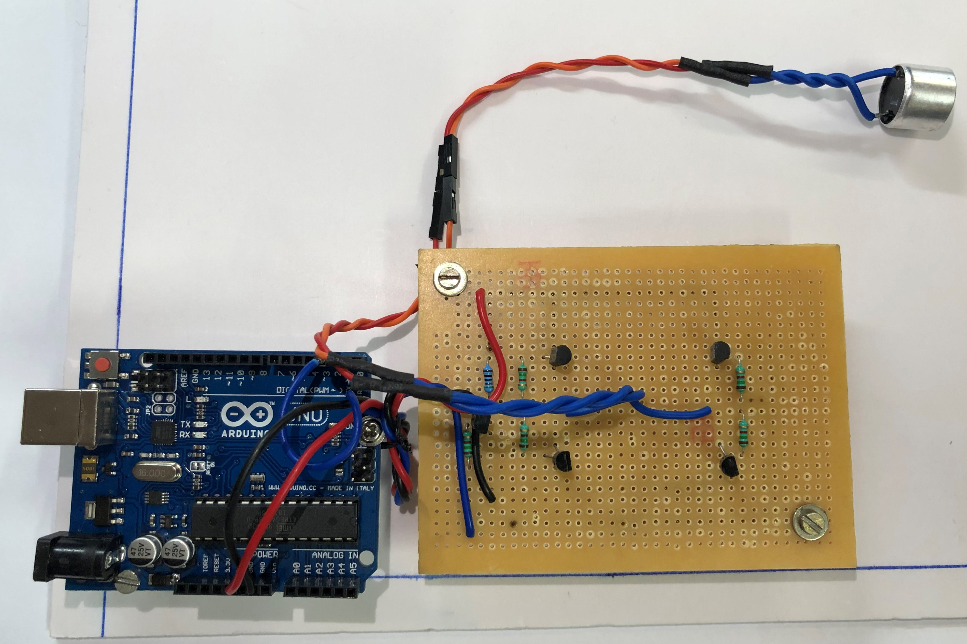
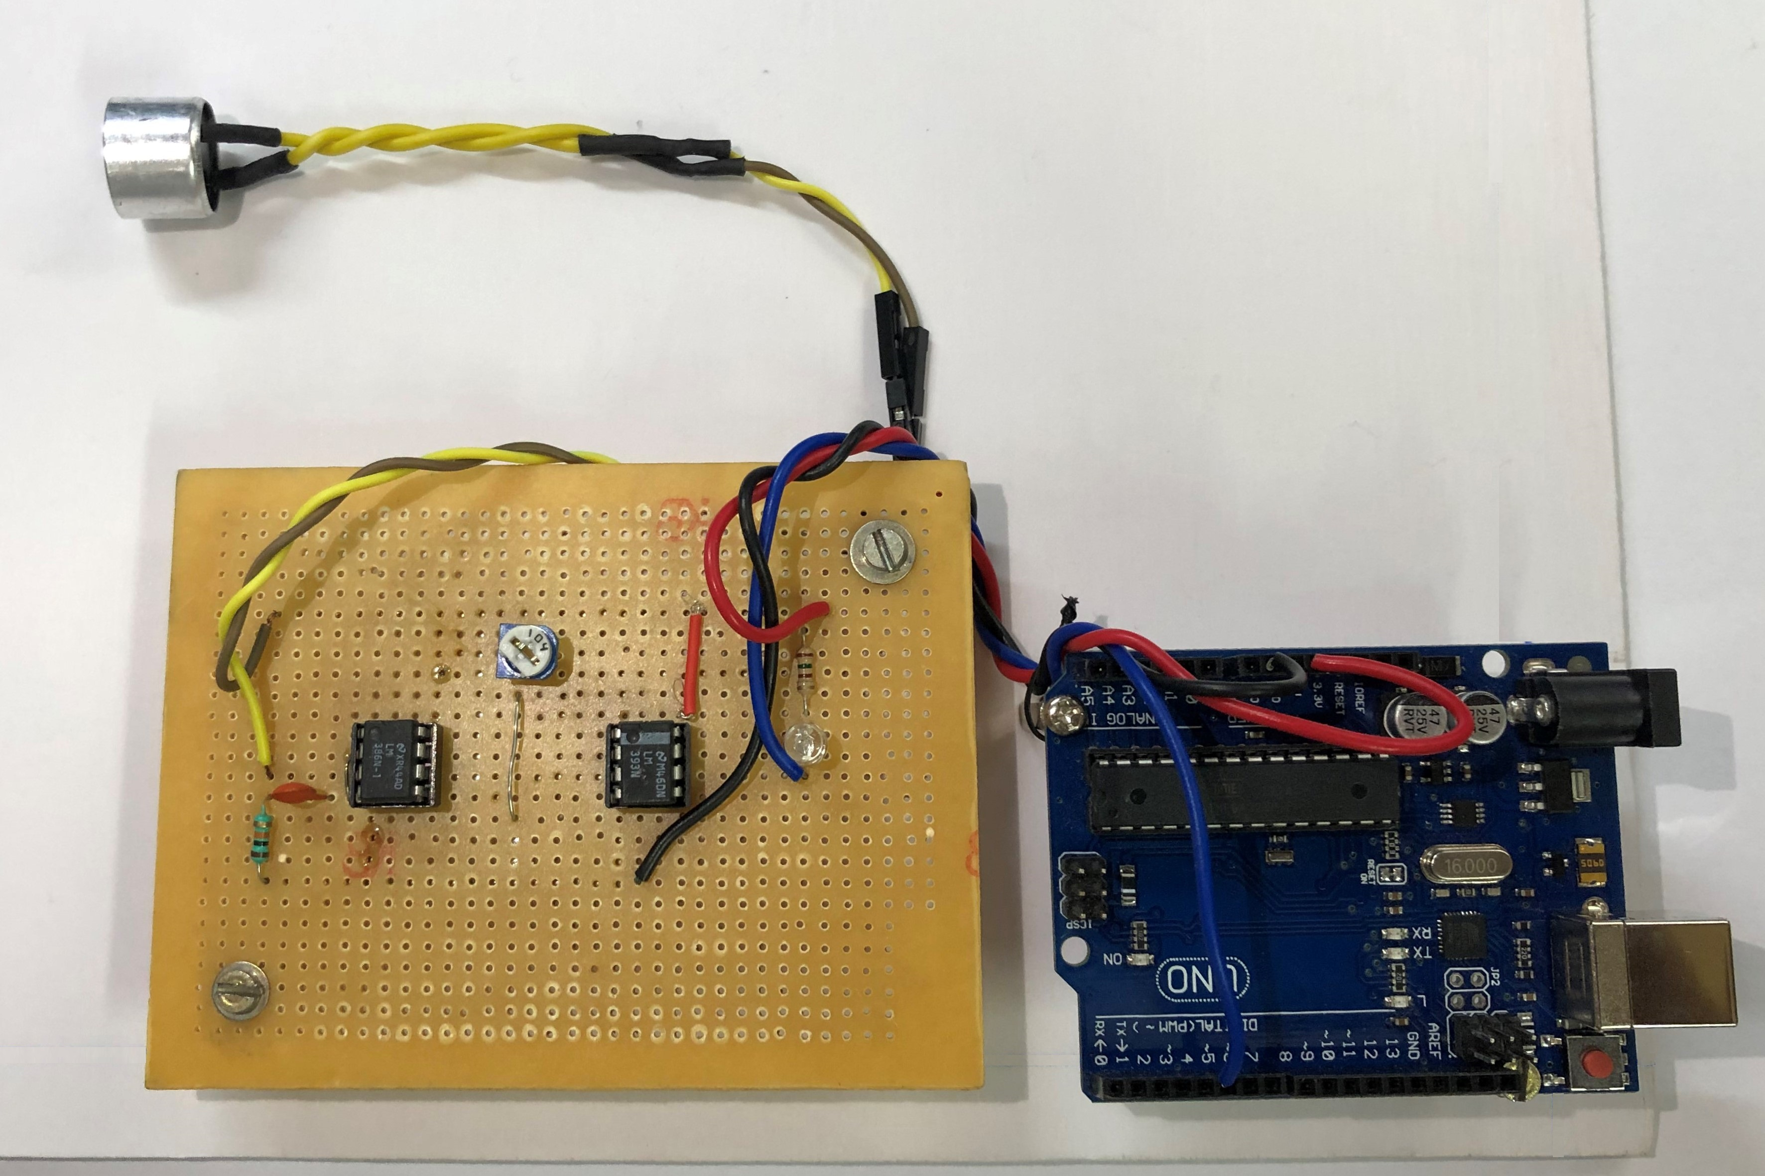
Developed Hardware
Transmitter Hardware
Receiver Hardware

Slide 14
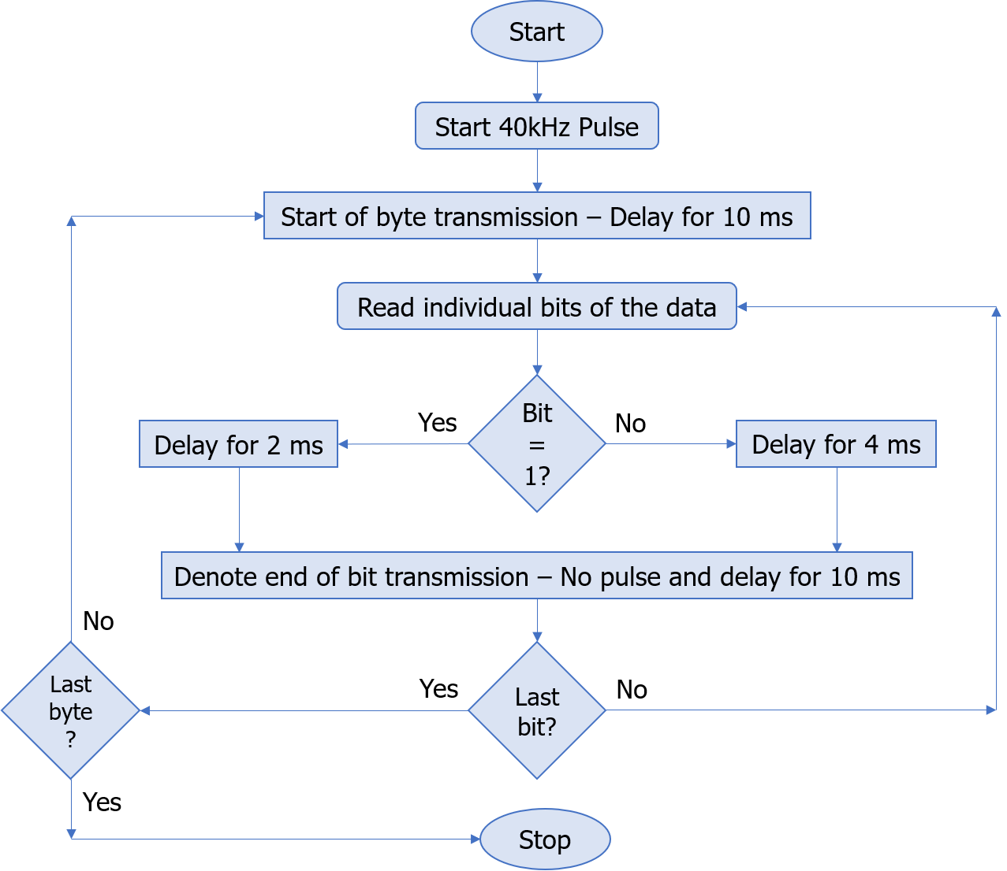
Transmission Algorithm
Notes:
Tone() - Generates a square wave of the specified frequency on specified pin with 50% duty cycle

Slide 15
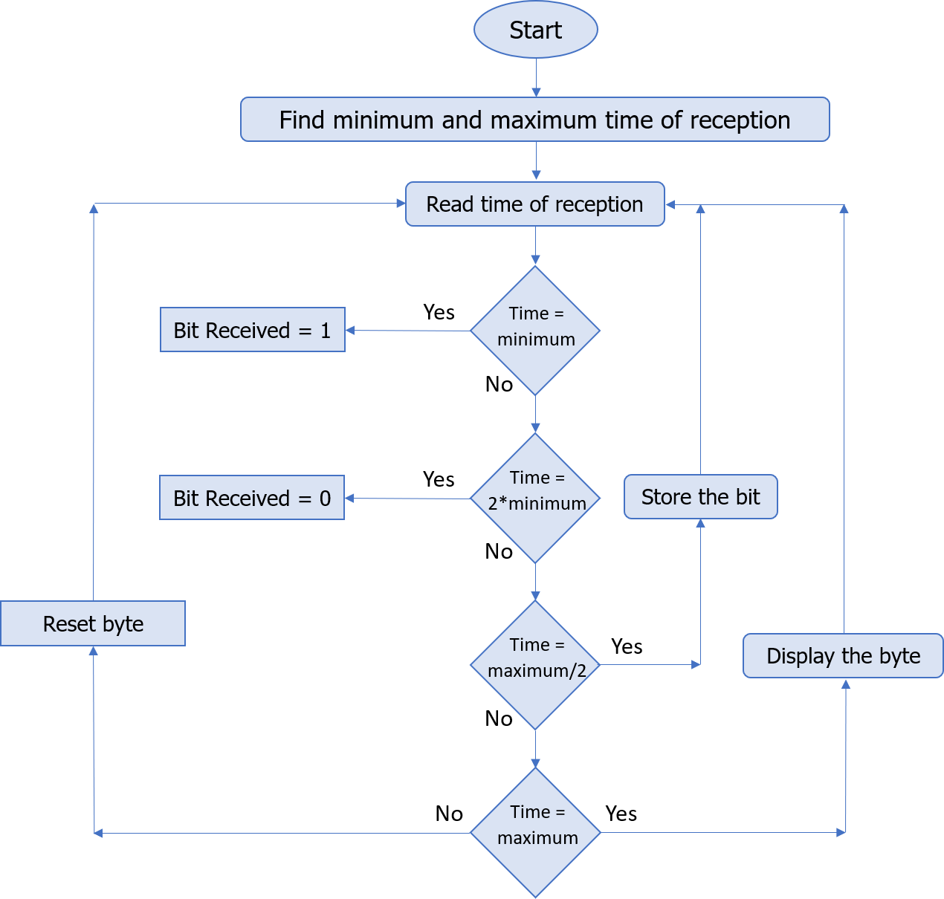
Reception Algorithm
Notes:
Tone() - Generates a square wave of the specified frequency on specified pin with 50% duty cycle

Slide 16
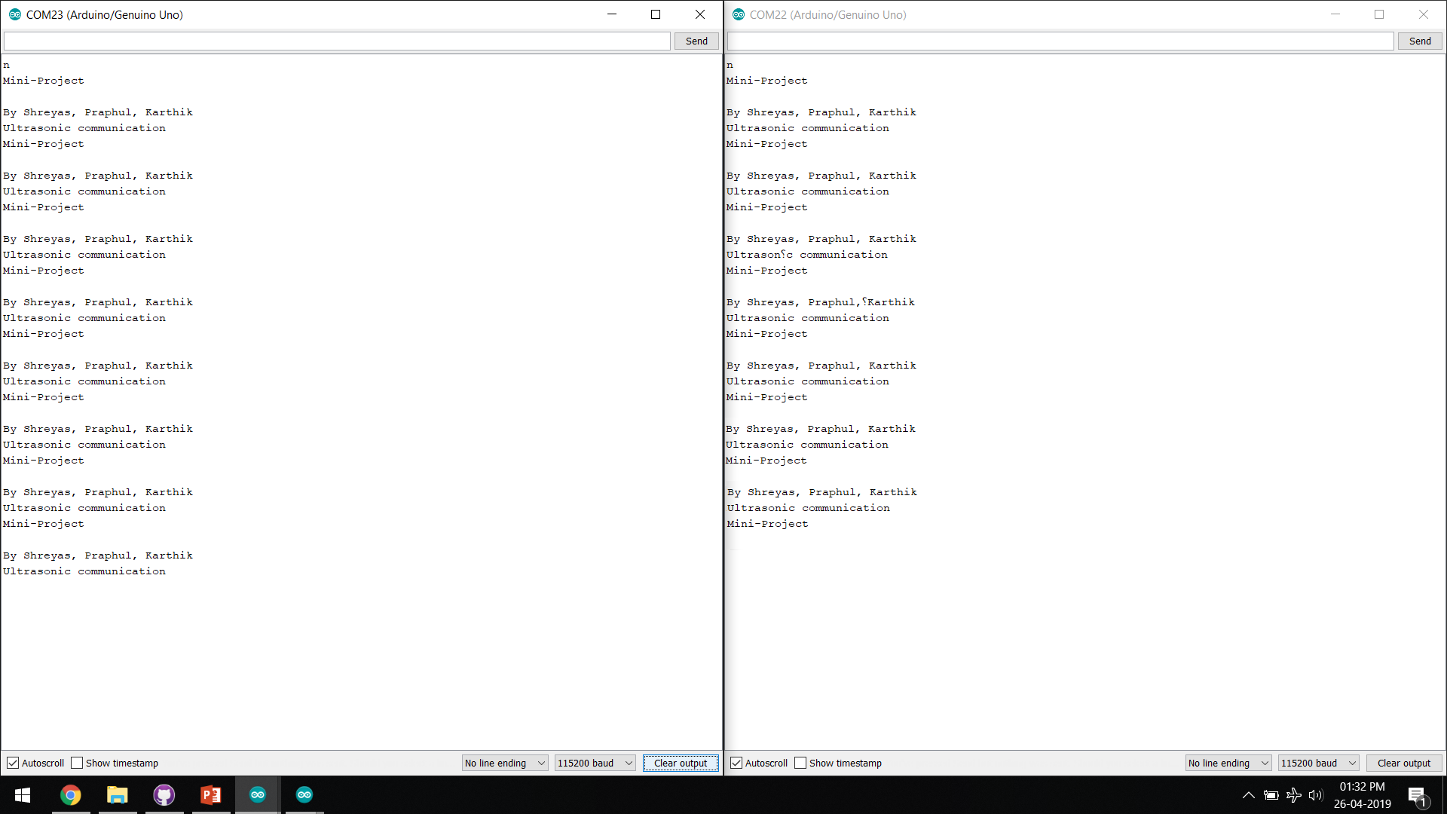
Results
Output in Serial Monitor of Transmitter of data transmitted
Output in Serial Monitor of Receiver of data received

Slide 17
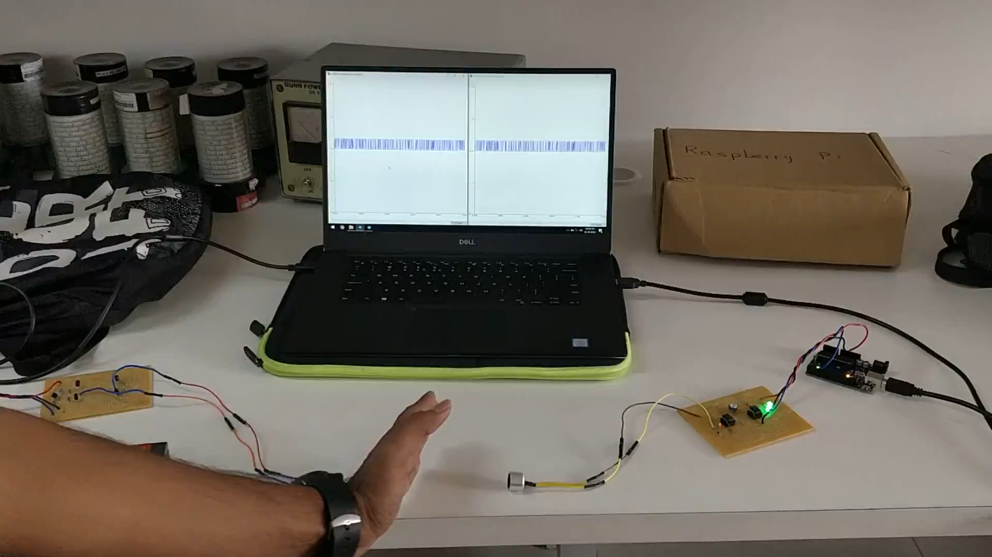
Demo Video

Slide 18
Applications
Ultrasonic data transmission can be used under-water.
Short-range resource sharing between devices.^{[4]}
Data transmission in places where electromagnetic radiations are harmful e.g. Petrol bunks, Healthcare

Slide 19
Conclusion
Data can be effectively transmitted with ultrasonic sound with considerable transmission speed.
Data Transmission through ultrasonic sound can be employed for short ranges and small data packets.
The designed prototype works only when transmitter and receiver transducers are in line-of-sight.

Slide 20
Future Scope
To improve the prototype for dynamic length of transmission
Find better, efficient algorithm to increase the speed of transmission
Interface with smartphones
To help in transfer of data in electromagnetic sensitive zones.
To help in pairing of devices. ^{[4]}

Slide 21
Progress Timeline
Week 1
Literature Survey
Week 2
Understand working of Transducer and HC-SR04
Week 3
Design and simulation of Transmitter circuit #1
Week 4
Week 5
Design and simulation of Transmitter circuit #2
Design and simulation of multiple receiver circuit
Week 6
Building and testing the transmitter circuit

Slide 22
Progress Timeline
Week 7
Building and testing the receiver circuit
Week 8
Developing the algorithm and code for transmission
Week 9
Developing the algorithm and code for reception
Week 10
Week 11
Testing the hardware
Verifying the outputs
Week 12 & 13
Changes to hardware
Compiling the results
Attempt to find algorithm for dynamic length of transmission

Slide 23
References
Pascal Getreuer, Chet Gnegy, Richard F. Lyon, Rif A. Saurous, “Ultrasonic Communication Using Consumer Hardware”, IEEE Transactions on Multimedia, Volume: 20, Issue: 6, pages: 1277 – 1290, 2017.
Igor Bisio, Alessandro Delfino, Aldo Grattarola, Fabio Lavagetto, Andrea Sciarrone, "Ultrasounds-Based Context Sensing Method and Applications Over the Internet of Things", Internet of Things Journal IEEE, vol. 5, no. 5, pp. 3876-3890, 2018.
Jafar Saniie, Boyang Wang, Xin Huang, "Information Transmission Through Solids Using Ultrasound Invited Paper", Ultrasonics Symposium (IUS) 2018 IEEE International, pp. 1-10, 2018.
Thuy Ong, The Verge, “Google’s new payment app for India uses sound to transfer money”, 2017.
TeamLisnr, “How Ultrasonic Data Transmission Compares to RF Protocols”, 2018.
Kerry D. Wong, “A Sensitive DIY Ultrasonic Range Sensor”, 2011.

Slide 24
References
kHz | Kilo Hertz
bps | bits per second
RF | Radio Frequency
dB | Decibels
dB SPL | Sound Pressure Level (1 Pascal is equal to SPL of 94 dB)
m | meter
SNR | Signal to Noise Ratio
GND | Ground

Slide 25
Thank You

Slide 26
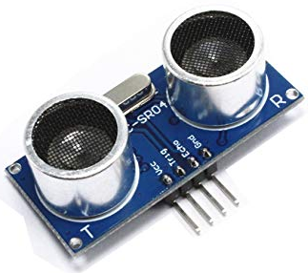
HC-SR04
HC-SR04 is an ultrasonic distance sensor.
It has two transducers – one acting as a transmitter and the other as receiver.
It has four pins:
VCC – Positive terminal of the power source.
Trig – Trigger pin to send burst of ultrasonic.
Echo –Echo pin to receive the reflected ultrasonic sound.
GND – Negative terminal of power source

Slide 27
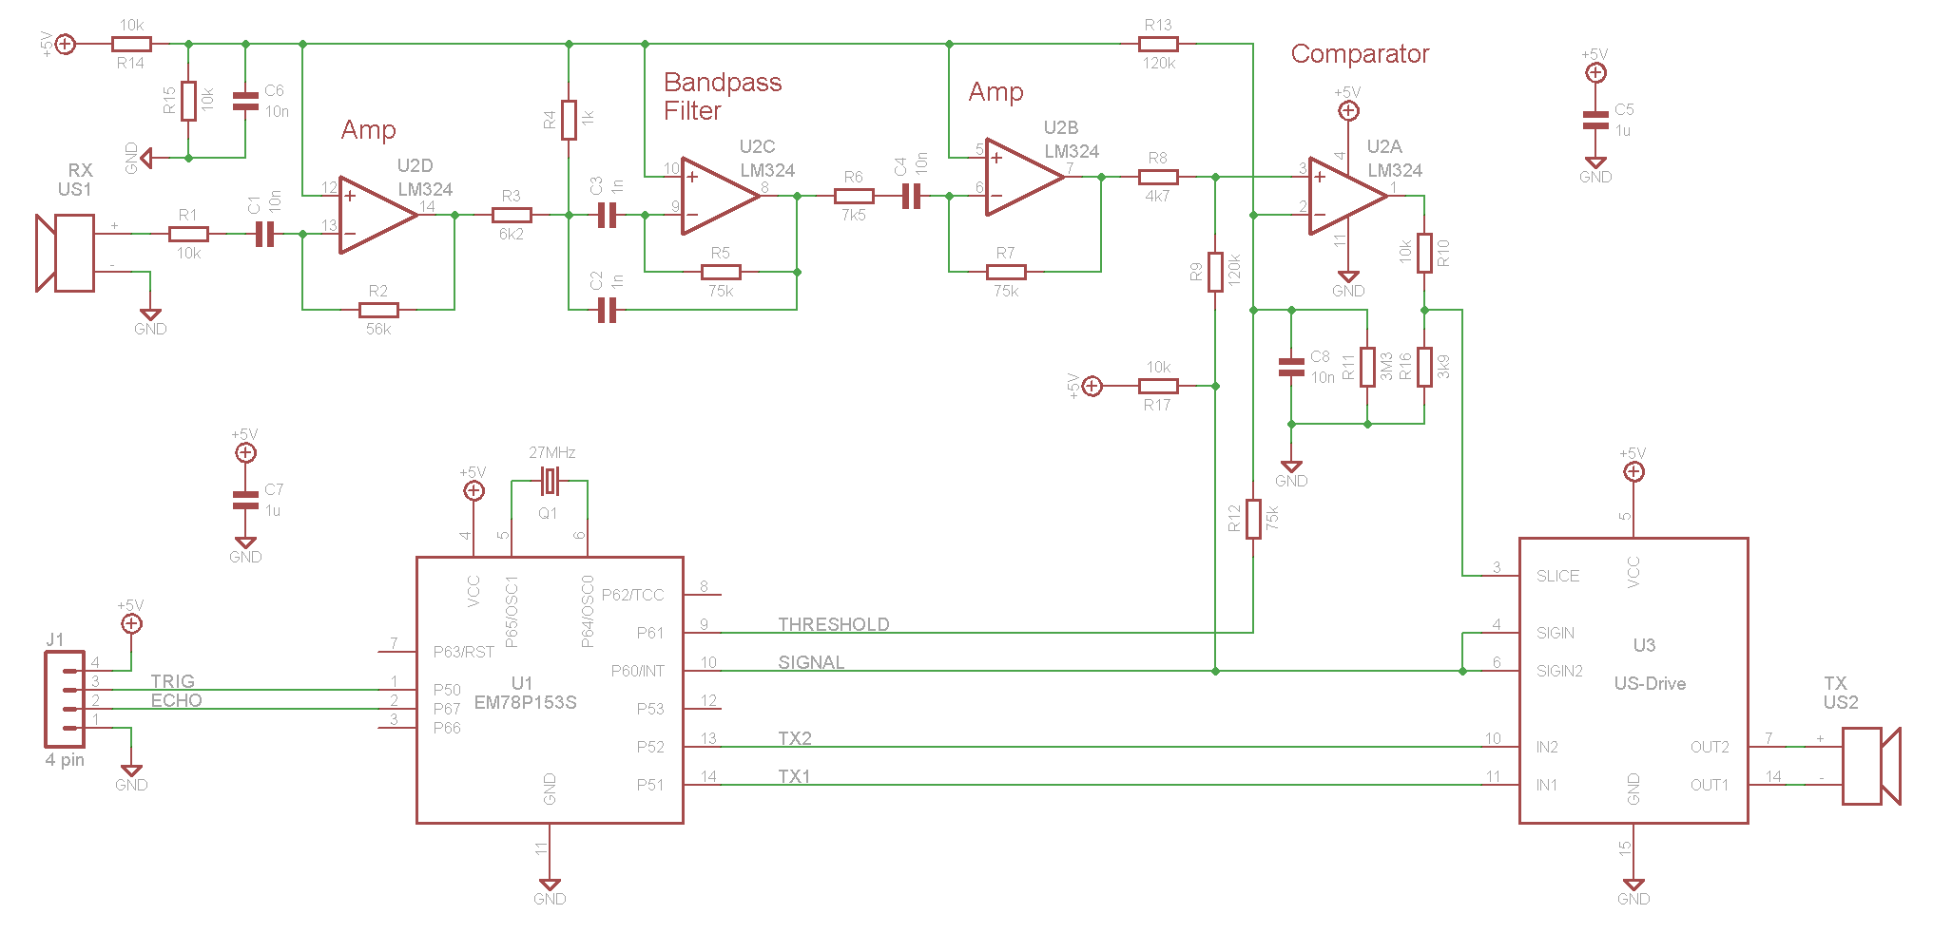
HC-SR04 Circuit
HC-SR04 Ultrasonic sensor circuit

Slide 28
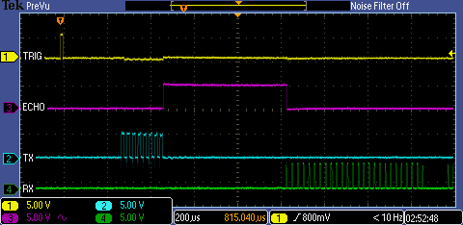
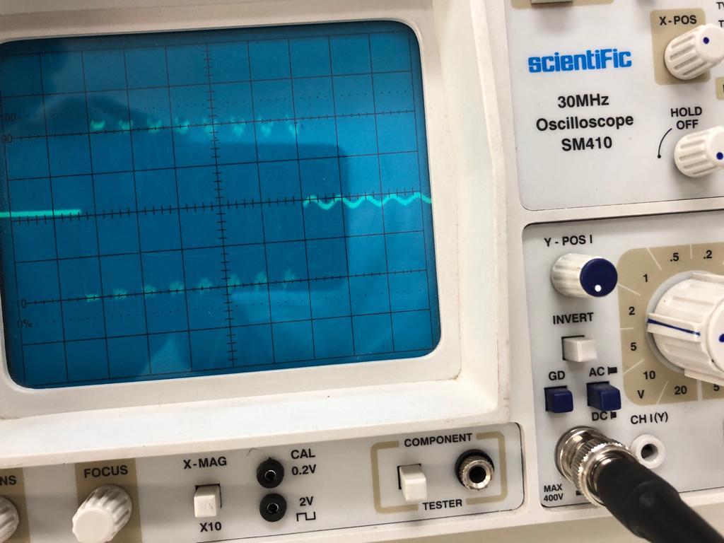
Working of HC-SR04
Trigger pin is given a pulse.
A burst of 8 pulses of 40 kHz is sent via transducer.
The echo pin is set high.
Once reflected wave is detected, the echo pin is set low.
Scope shot of signal timing
(Source: pcserviceselectronics.co.uk)
Scope shot at Tx
(Taken at lab)

Slide 29
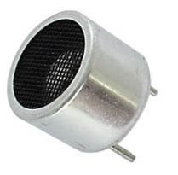
Transducers
The transducer is a device that converts electrical signal to physical quantity or vice versa.
The main criteria to choose a ultrasonic transducer are the resonant frequency, radiation pattern and sensitivity.
Sensitivity affects the efficiency of the transducer and also attributes to the SNR.
For the receiver and transmitter, we would be using 40 kHz ultrasonic transducer.
Notes:
>> With properly designed circuits these sensors can easily achieve a range of more than 20 feet.
>> The power rating of the transducer is quite low when compared with other transducers and the optimum operating voltage is around 6 volts.

Slide 30
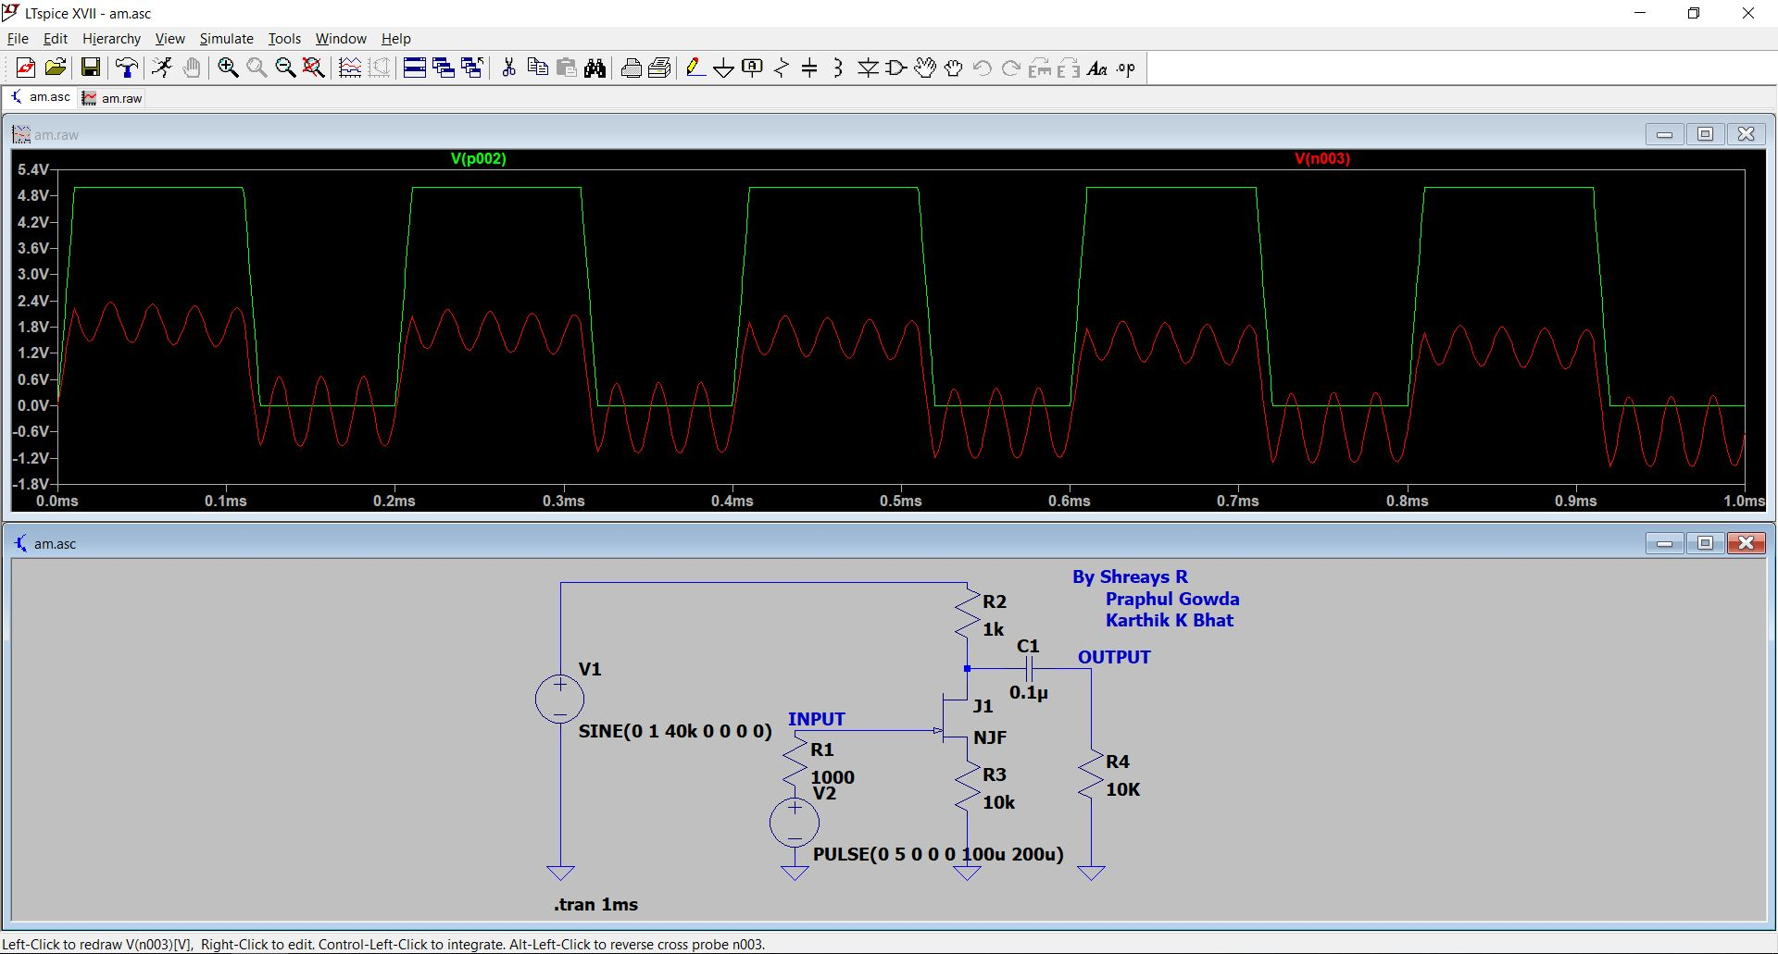
Transmitter Circuit #1 Simulation
Simulation of Amplitude Modulation Circuit using JFET on LTSpice software

